Slide 1
CONFERENCE PORTAL
TEAM MEMBERS:
(i) Rohan Kundu -1706257
(ii) Rohan Sinha - 1706258
(iii) Jatindra P Singh - 1706226
Under the guidance of :
Prof. Kumar DevDutta

Slide 2
ABOUT OUR PRODUCT
A customized portal supporting various tasks such as paper submission, point of contact & details, accommodation, scheduling etc.
It will help to deliver the effortless experience of a hassle-free conference.
A single point of access for all the attendees to know the ins and outs of the conference.

Slide 3
ADVANTAGES OF USING THE PORTAL
1. Saves Resources : Paper-free conferences save trees, ink, and other resources, which is great for the environment.
2. Convenience : The organizer can access information through a board portal anywhere and anytime using a computer or mobile device.
3. Efficiency : Using a portal to preview information prior to conferences reduces the time spent in conferences and improves the productivity of the organizing committee. Plus before, during and after conferences, organizers can add notations, bookmarks, and highlights to make their electronic packet easier to read.

Slide 4
ADVANTAGES OF USING THE PORTAL
4. Security : Portals have various security features that control who is authorized to enter the system, view meeting minutes and modify documents. Passwords, encryption and other protective measures ensure directors can access the different types of sensitive information they need to perform their duties.
5. Improves Communication and Collaboration : Having reliable access to digital information enhances overall communication between participants during and in conference.

Slide 5
TECHNOLOGY USED
1) HTML 5) Node.js
2) CSS 6)Express.js
3) BOOTSTRAP 7) MongoDB
4) JAVASCRIPT

Slide 6
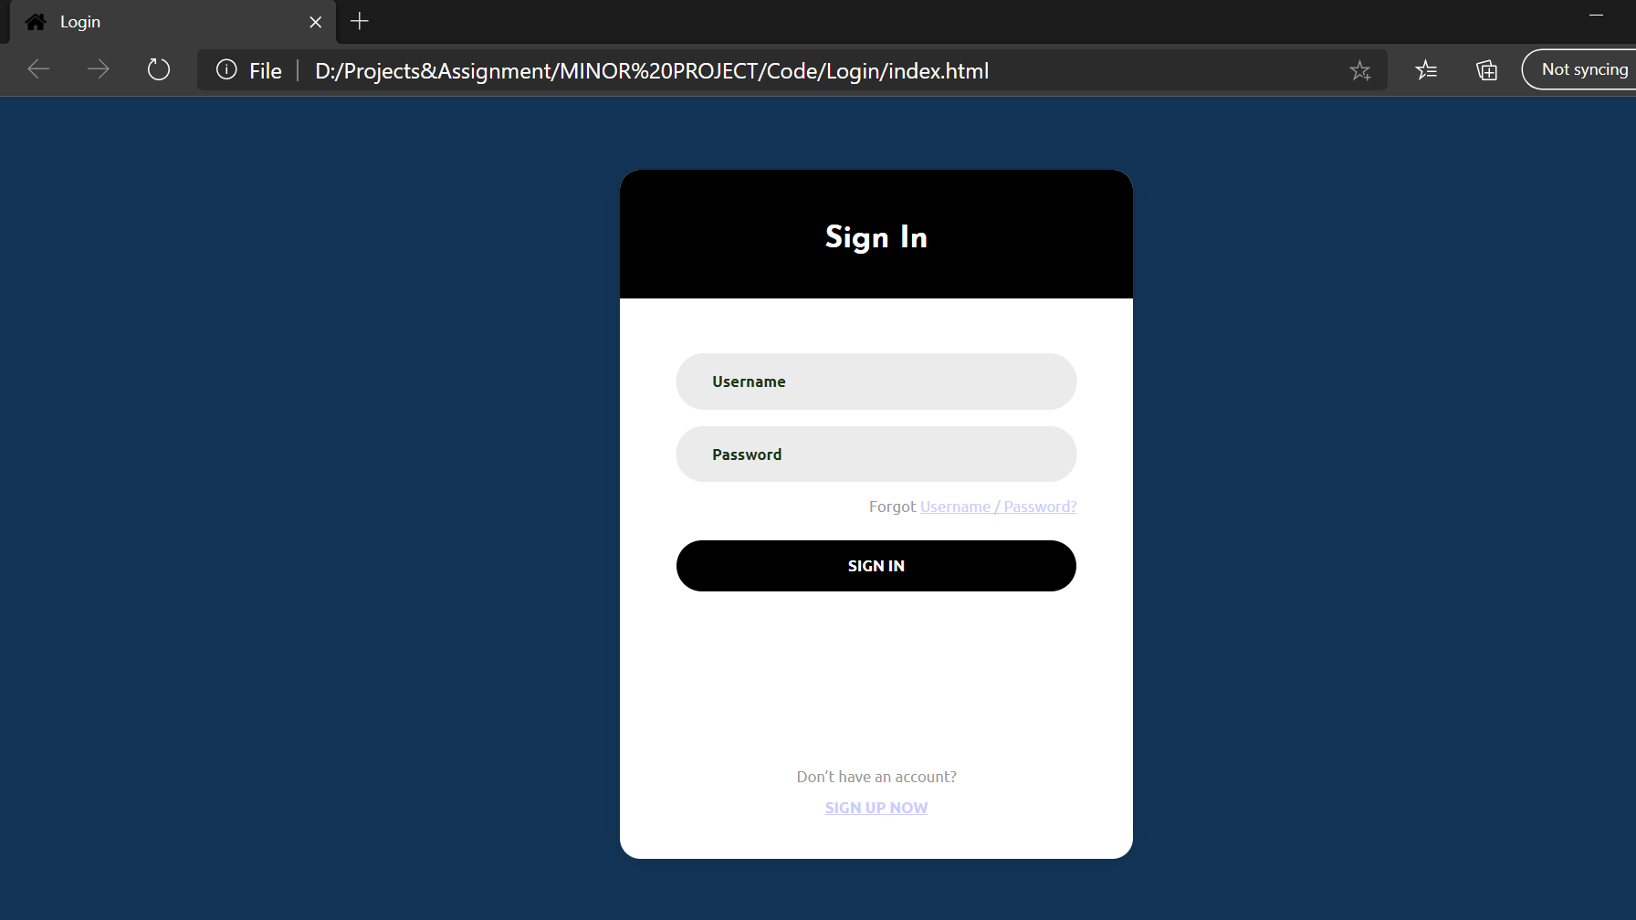
SNAPSHOT OF PROJECT

Slide 7
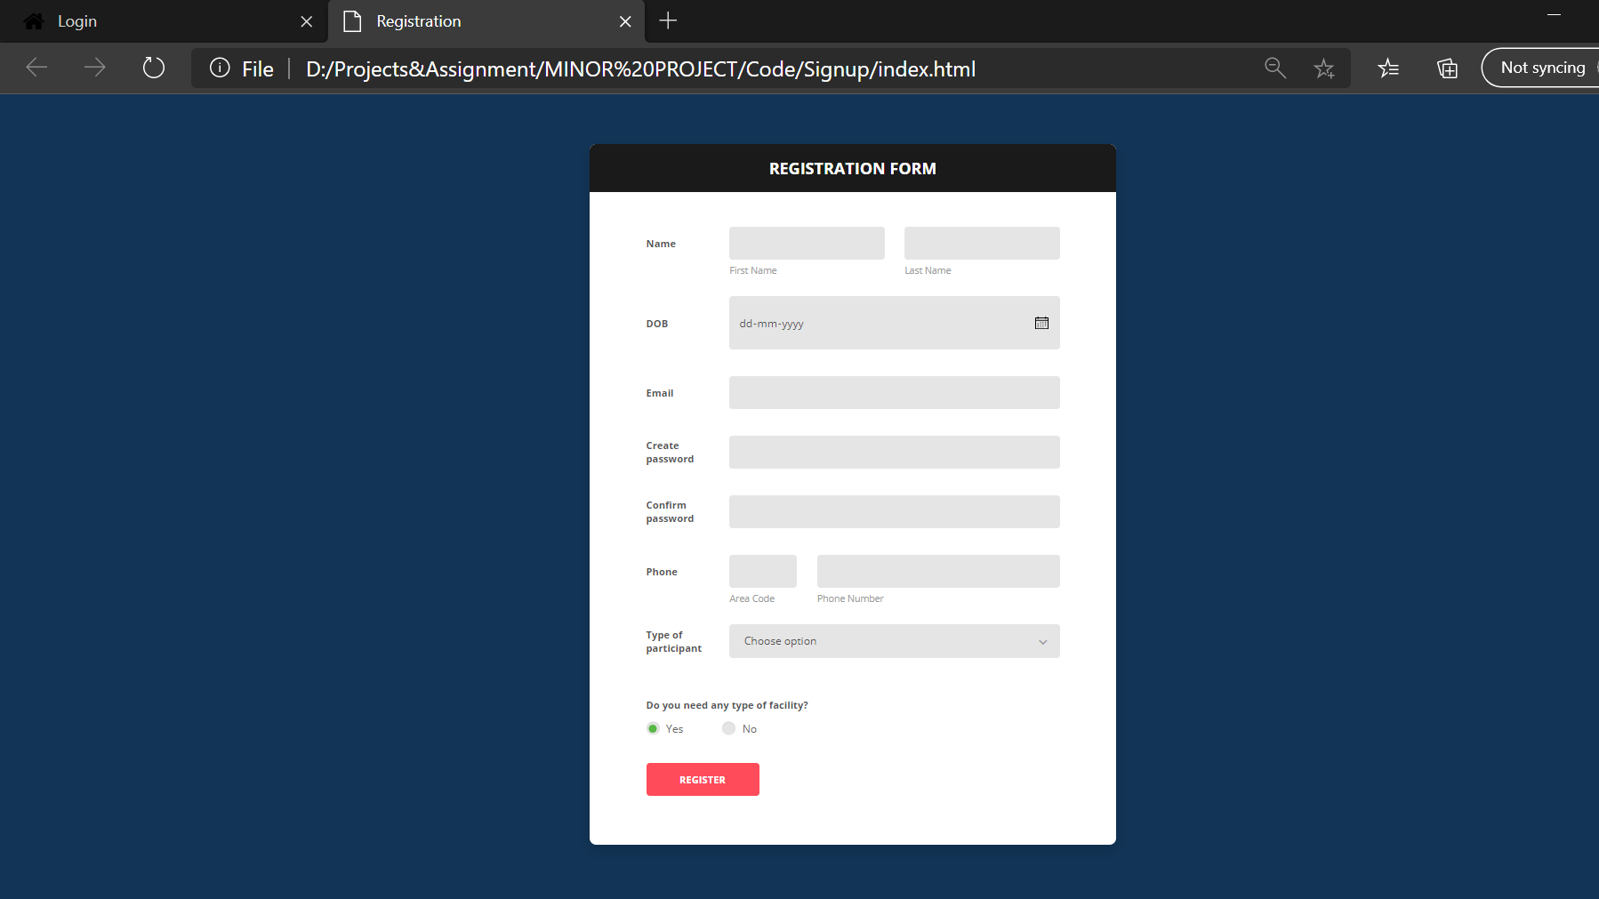
SNAPSHOT OF PROJECT

Slide 8
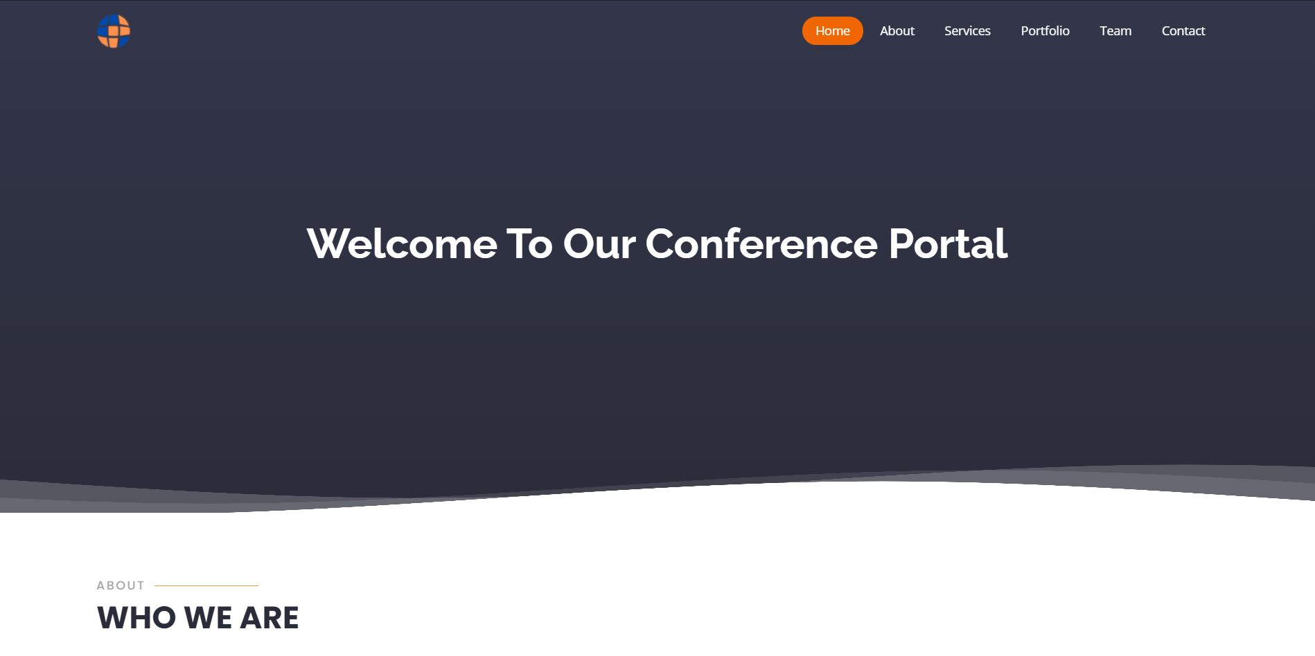
SNAPSHOT OF PROJECT

Slide 9
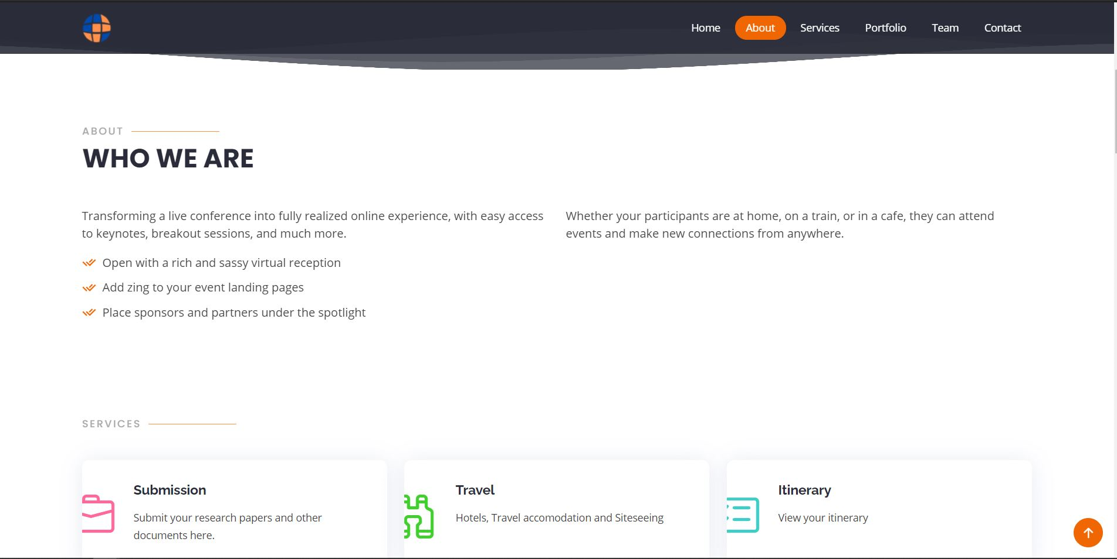
SNAPSHOT OF PROJECT

Slide 10
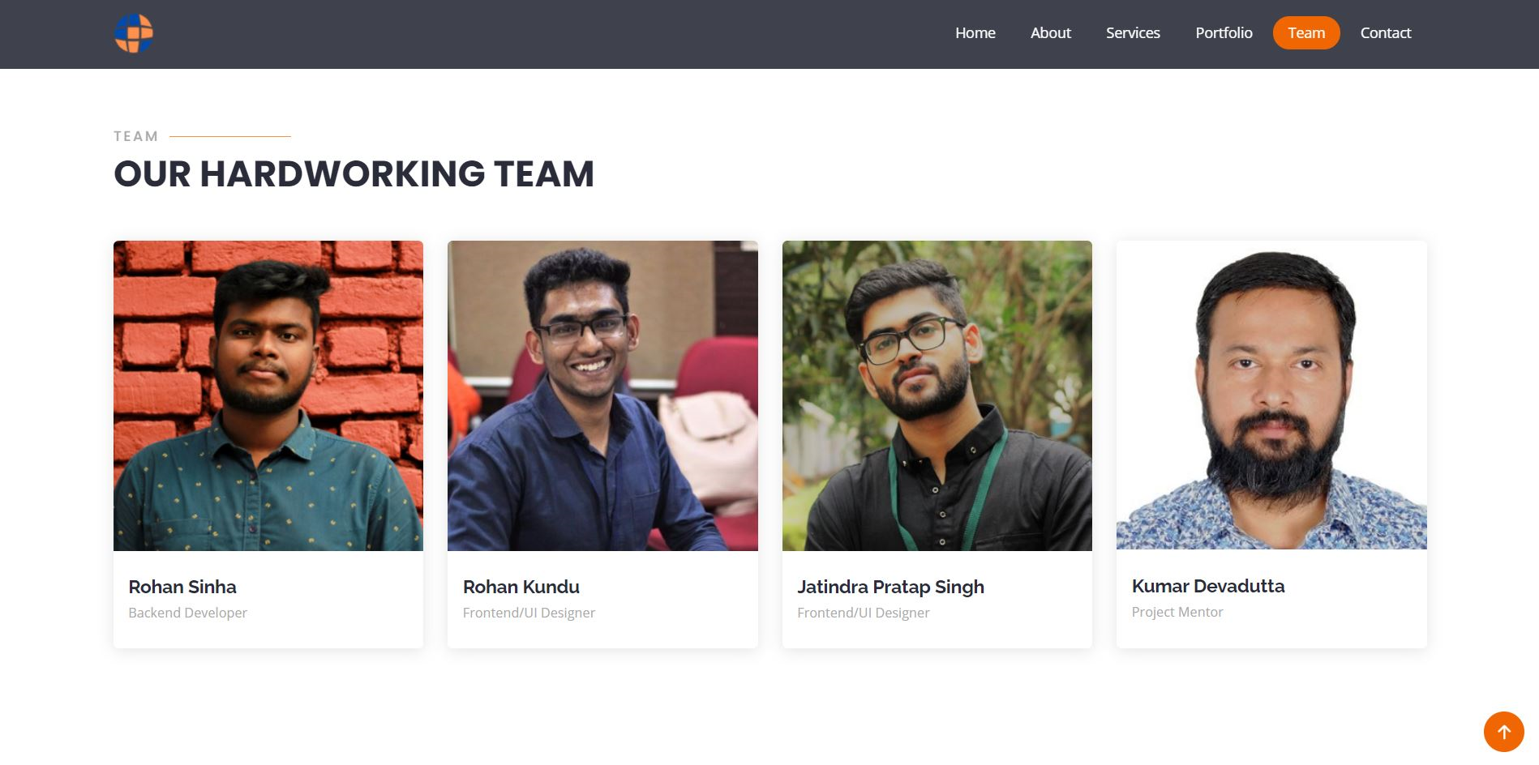
SNAPSHOT OF PROJECT

Slide 11
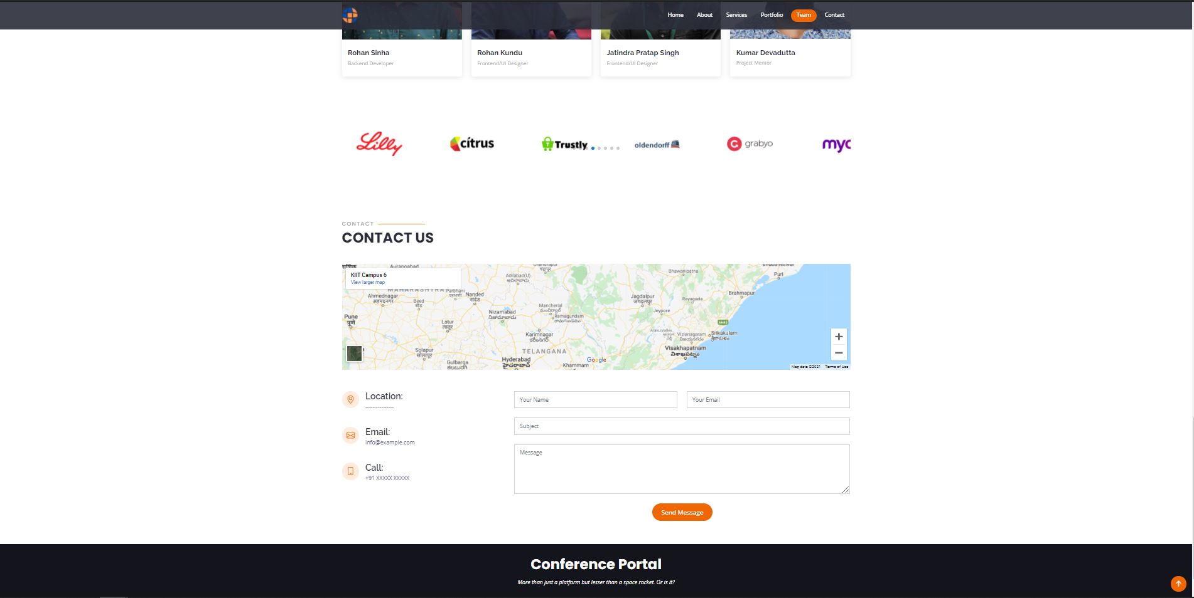
SNAPSHOT OF PROJECT

Slide 12
FUTURE SCOPE
We will be hosting this portal live by the help of web servers.
We will be adding e payment methods.
In view of the covid-19 spread people are getting more inclined towards online mediums as organizing a conference would mean gathering a significant number of people in a closed area risking the spread of the virus. So, we can add some tweaks to our portal allowing the conference to be held online.

Slide 13
THANK YOU

